Slide 1
Software Engineering
Lesson – UML Sequence Diagrams

Slide 2
Lesson Content
What is a Sequence Diagram
General Notation
Components of a Sequence Diagram
Guidelines

Slide 3
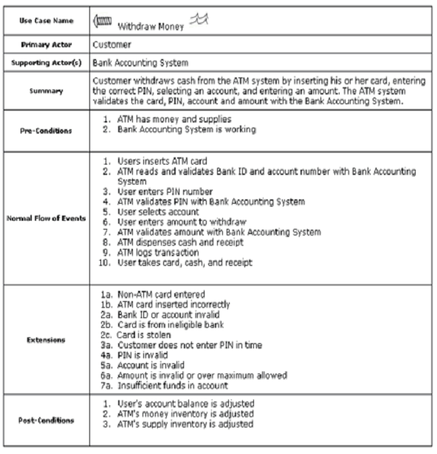
Interaction Diagrams
3
Use Case and Class Diagrams are static representation of the system
Sequence diagrams are used
to explore the dynamic nature of your system.
to model the behavior of use cases by describing the way groups of objects interact over time to complete a specific task.
Sequence Diagram captures the behavior of a single scenario [2]
Shows number of objects and messages that are passed between these objects within the use case

Slide 4
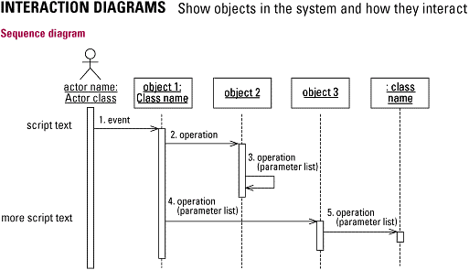
What is Sequence Diagram?
4
A sequence diagram represents the interaction between different objects (participants) that occurs for one use case arranged in a time sequence.
Sequence diagram captures the invocation of methods in each object, and the order in which the invocation occurs
Diagram has two dimensions:
A time dimension
Dimension that represents the participants in a sequence of events required to achieve a purpose.

Slide 5
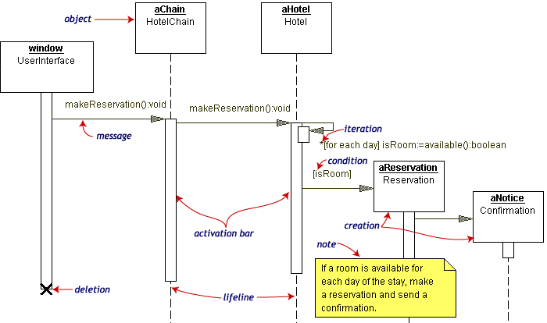
Sequence Diagram: General Notations
5

Slide 6
Components of Sequence Diagram
6
Participants which are playing roles in a use case sequence
In UML 1 these were objects and their names were underlined
In UML 2 participants are named using syntax name: Class or : Class
Each vertical dotted line is a lifeline, representing the time that an object exists.
Each arrow is a message call
Message is a name of an operation belonging to the object
Messages often carry parameters which are then used (evaluated) by the objects relevant operations
The activation bar represents the time that an participant is performing an action (participant’s methods being on stack).

Slide 7

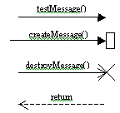
Notations and guidelines
7
Element and its description | Symbol
Object: The primary element involved in a sequence diagram is an Object—an instance of a class. A Sequence diagram consists of sequences of interaction among different objects over a period of time. An object is represented by a named rectangle. The name to the left of the ":" is the object name and to its right is the class name.
Message: The interaction between different objects in a sequence diagram is represented as messages. A message is denoted by a directed arrow. In a Sequence diagram, you can represent simple messages, special messages to create or destroy objects, and message responses. First message doesn’t have a participant that sent it as it comes from an undetermined source. It’s called found message Note: The general idea is that the receiver of the message will implement the corresponding operation, so it makes sense that the message name be close to that object.

Slide 8
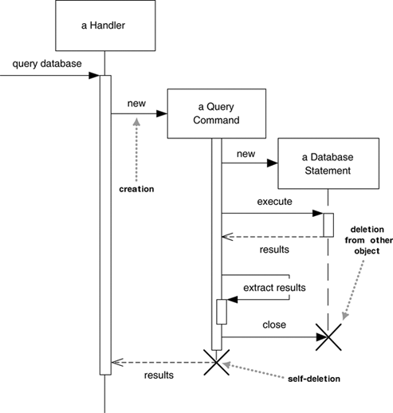
Participants Creation and Deletion
8
To indicate Object Creation on a sequence diagram.
Show directly creation by dropping the object down in your diagram and invoking a message into its side.
Send a message with the name “new” (optional)
Object Deletion is likewise denoted by a message arrow that terminates on an X at the end of the object’s lifeline.
X at the end of a lifeline shows a participant deleting itself

Slide 9
Sequence Diagrams: Advantages and Disadvantages
9
Advantages
Good for visualization of how objects interact
Make sequence of calls clear
Give good picture on who is doing which processing
Disadvantages
Not good in showing details of algorithms: loops, conditions, etc (although possible)

Slide 10
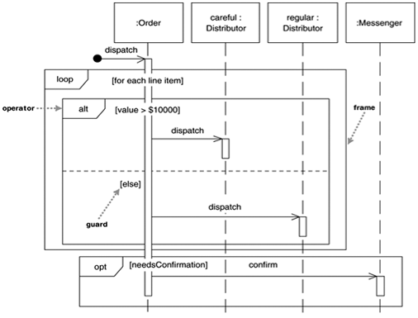
Loops and conditionals
10
procedure dispatch
foreach (lineitem)
if (product.value > $10K) careful.dispatch
else regular.dispatch
end if
end for
if (needsConfirmation) messenger.confirm
end procedure
Loops and conditionals use interaction frames (separating or marking off a piece of sequence diagram)
have been introduced in UML 2.
frames consist of some region of a sequence diagram that is divided into one or more fragments.
Each frame has an operator and each fragment may have a guard.

Slide 11
Common operators for interaction frames
11
Interaction frames can have a number of operators. For example:
alt – Alternative multiple fragments; only the one whose condition is true will execute
opt - Optional; the fragment executes only if the supplied condition is true. Equivalent to an alt with only one trace
loop - Loop; the fragment may execute multiple times, and the guard indicates the basis of iteration
par – Parallel; each fragment is run in parallel
region – Critical region; the fragment can have only one thread executing at once
sd – sequence diagram; used to surround an entire sequence diagram, if you wish

Slide 12
Synchronous and Asynchronous calls
12
UML 2 introduced new notation
if a caller sends a synchronous message (shown with a filled arrowhead), it must wait until the message call is finalized, before it continues processing.
if a caller sends an asynchronous message (stick arrowheads) , it can continue processing and doesn't have to wait for a response (used to be half stick arrowhead).

Slide 13
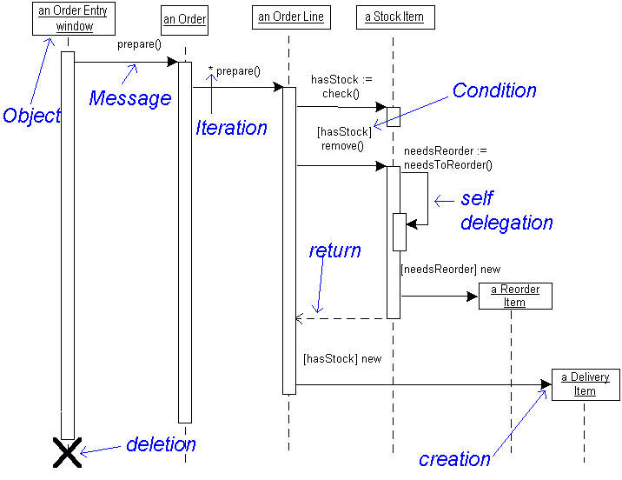
Another example of sequence diagram
13

Slide 14
When to use Sequence Diagrams
14
Use sequence diagrams when you want to look at the behavior of several objects within a single use case.
Sequence diagrams are
good at showing collaborations among the objects;
not so good for showing the behavior of one object (use state transition diagram)
not so good at precise definition of the behavior (use activity diagram)

Slide 15
Reference List
[1] Venters W, 2008, Software engineering: theory and application: chapter 7, pp 56-58, LSE, University of London
[2] Fowler M, 2003, UML Distilled. A Brief Guide to Standard Object Modelling Language, Addison Wesley, 3rd edition

Slide 16

End of Lesson
Any questions?

